Slide 2
Paragraph 1:
Sam arrived very early the next morning. Seeing Roland lazily bathed in mild sunshine with eyes narrowed into a line, Sam darted towards him, arms widely opened. Giving him a lazy glimpse, Roland politely wagged his tail and then turned his head away, falling sound asleep again. Desperately brainstorming, Sam got a piece of delicious bone from Mrs. Proudfoot. Lured by the tasty smell, Roland swiftly bounced up and jumped at the bone, following Sam out. In this way, the first day was smoothly finished. Day by day, Sam was delighted to find Roland gradually become willing and eager to have a walk outside.

Slide 3
Paragraph 2：
A month later, Mrs. Proudfoot was delighted to find Roland fit and energetic. Enjoying the pleasure to roam along the country road with Roland, Sam also harvested a lot from the relaxing time. Eventually one day, Sam was excited to tell Mrs. Proudfoot, “Barry and I have earned enough money. Thank you, Mrs. Proudfoot! But can I continue walking Roland for you? For free!” Radiantly, Mrs. Proudfoot nodded. Receiving a positive answer, Sam was wild with joy and Roland, wagging his tail merrily, as if intoxicated (喝醉；陶醉）. Sometimes only a little kindness can ignite（点燃；引起） something shining, making the world more beautiful and harmonious.

Slide 4
Sam arrived very early next morning. Whistling and beckoning 示意,召唤,Sam tried to lure Roland out of the house. Sleepy as he was, he wriggled（扭动） up and trailed(无精打采地走） after Sam. “Come on, you lazy dog!” Sam clapped his hands, trotting ahead. Vigor（活力） seemed to be slowly seeping渗出,漏 into the beast, for he began to bound up and down, sniffing here and there, his tail wagging like mad in the morning breeze. Half an hour later, Sam returned, sweats beading\oozing on his forehead and Roland followed, his tongue lolling out(loll out 伸出), panting for breath. In this way, the first walking finished smoothly.

Slide 5
A month later, Mrs. Proudfoot was delighted to find Roland fit and energetic. Gratitude and love filled her heart. The next morning, she pre-paid？ Sam a month’s salary. Money in hand, Sam dashed out with Roland for their daily exercise, his blooding？ surging. Joy urged them upon an unfamiliar path. Like always（一如往常）, Roland sniffed, his head poking伸出 around. Suddenly, he barked loudly. Turning his gaze towards the dog, Sam found, lying beside the bush, the book Barry had lost! Picking it up in ecstasy(with wild joy), Sam hastened back to return the money. “Keep it, son. You deserve it!” Mrs. Proudfoot stroked his head with an amiable和蔼可亲的 smile.

Slide 6
beckon：招手示意；举手召唤
He beckoned her over with a wave. 他挥手让她过去。
trail：to walk slowly because you are tired or bored, especially behind sb else （尤指跟在他人后面）疲惫地走，没精打采地慢走，磨蹭
The kids trailed around after us while we shopped for clothes.
我们在商店买衣服时，孩子们无精打采地跟在后面

Slide 7
poke:刺，捅；戳；伸出；刺探；闲荡
He poked the fire with a stick. 他用一根棍子拨旺火。
The kids poked holes in the ice with sticks.
孩子们用棍子在冰上戳洞。
He poked his head around the corner to check that nobody was coming. 他从转角处探出头来，查看有没有人过来
I poked my way to the front of the crowd.
我挤到了人群的前面
Clumps of grass poked up through the snow.
一簇簇的草破雪而出。

Slide 8
Though Mrs. Proudfoot was a lonely widow, her heart was brimful of happiness and warmth. “Roses given, fragrance in hand”. She actually fulfilled herself by helping others.
哲理性结尾
2. Bathed in the radiant glows of the rising sun, enjoying tender breeze kissing her cheeks, peering at the boy and the dog vigorously jumping ahead of her, Mrs. Proudfoot couldn't help sensing the magic of “being loved! '' 情景交融
being loved and accompanied

Slide 9
3.Now the people in the neighborhood can often catch sight of a young boy and a once overweight, now fit shepherd walking together at sunrise, one talking as if to a friend, one yipping(狗)吠 in reply. The sun cast a gorgeous （灿烂的）light on the both of them.
情景交融（和谐温馨）

Slide 10
4.Such September was rather beautiful and pleasant, with gentle breeze stirring the branches, birds singing, the big and small figure running. 呼应前文
5.Their sounds of laughter and singing mingled in the fresh air, expressing the pleasures of life.
寓情于景
A slight breeze was stirring the branches. 微风吹动着树枝。
She was stirred by his sad story. 他那悲惨的故事打动了她

Slide 11
一条棕黄色的瘦狗在东嗅嗅西嗅嗅。意识到有人来了，迅速地跳到一边，耳朵后竖，夹着皮包骨头的尾巴跑了。
A lean(瘦) brown dog was sniffing around here and there. When aware of people approaching, he swiftly leaped sideways and fled, ears back up, bony tail clamped protectively.
sniff 嗅，闻
leap 跳跃
bony 皮包骨头
clamp 夹紧

Slide 12
一条厚毛黄色牧羊犬一路小跑而来,低着头,舌头耷拉着,滴着口水.尾巴懒洋洋地卷着,大声地喘着气.
A thick-furred yellow shepherd dog came trotting down the road, head low, tongue lolling and dripping. Its tail limply(柔软地,软绵绵地) curled, and it panted loudly.
loll 头,舌等耷拉,下垂: My head lolled against his shoulder.
我把头懒懒地靠在他的肩上
pant 气喘,喘息

Slide 13
1. I felt so scared that my throat tightened and my knees felt weak. (嗓子发紧，膝盖发软)
2. I froze with terror, too scared to move an inch. (吓呆了，不敢动弹)
3. The horrible scene made my blood run cold and struck fear into my heart.
那可怕的场面使我毛骨悚然，使我胆战心惊。
4.The horrible scene just made my hair stand on end.
5. My reply fueled mother’s anger and she erupted like a volcano.

Slide 14
Though Mrs. Proudfoot was a lonely widow, her heart was brimful of happiness and warmth. “Roses given, fragrance in hand”. She actually fulfilled herself by helping others.
哲理性结尾
2. Bathed in the radiant glows of the rising sun, enjoying tender breeze kissing her cheeks, peering at the boy and the dog vigorously jumping ahead of her, Mrs. Proudfoot couldn‘t help sensing the magic of “being loved! “ 情景交融

Slide 15
Now the people in the neighborhood can often catch sight of a young boy and a once overweight, now fit shepherd walking together at sunrise, one talking as if to a friend, one yipping(狗)吠 in reply. The sun cast a gorgeous light on the both of them.
情景交融

Slide 16
4.Such September was rather beautiful and pleasant, with gentle breeze stirring the branches, birds singing, the big and small figure running. 呼应前文
5.Their sounds of laughter and singing mingled in the fresh air, expressing the pleasures of life.
寓情于景

Slide 17
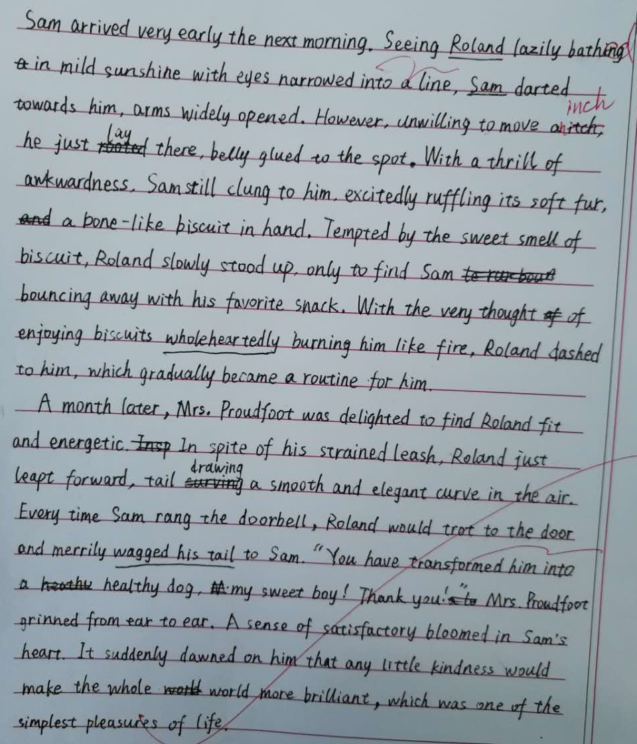
学生习作1：
这篇作文第一段的情节设计：Roland一开始不愿意跟Sam走，Sam用骨头饼干引诱Roland，并慢慢地让Roland喜欢上了这个活动的过程，情节设计合理。文中seeing，unwilling， excitedly ruffling, tempted, bouncing 等分词的使用使文中人和动物生动起来,且与第二段首句衔接,是亮点。
不足之处在于：little kindness would make the world more brilliant，主题提升合理，但在第二段的情节设计中体现的不够；原文中Sam帮Mrs Proudfoot 遛狗为了帮助朋友Barry 赚钱还清丢失书本的钱，这件事情在第二段里也没有后续提及。
总的来说，这位同学的语言基本功还是不错的，也有一定的积累。

Slide 18
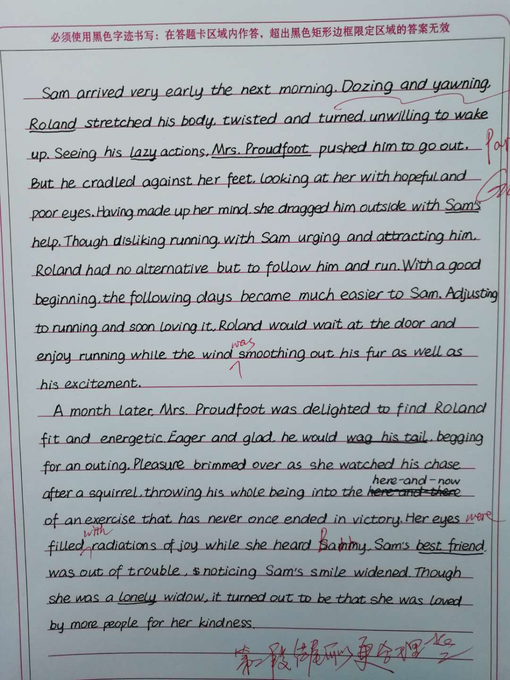
学生习作2：
这篇作文的亮点在于句子能以丰富的语言结构,如：v-ing,with 结构,adj.结构,v-ed等形式开头, 使文章读起来生动形象。情节构思合理，逻辑性较强。一、二两段衔接合理。主题提升方向是合理的,但是主题句的表达方式可以改进。比如可以这样表达：Though Mrs Proudfoot was a lonely widow, her heart was brimful of happiness and warmth. “Roses given, fragrance in hand”. She actually fulfilled herself by helping others.总的来说这位同学的语言有较多积累,功底不错。

